Slide 1

Analysis of Air fare's & Industry Trends
Uncovering Patterns and Strategically Tailoring Prices to Enhance Customer Value

Slide 2
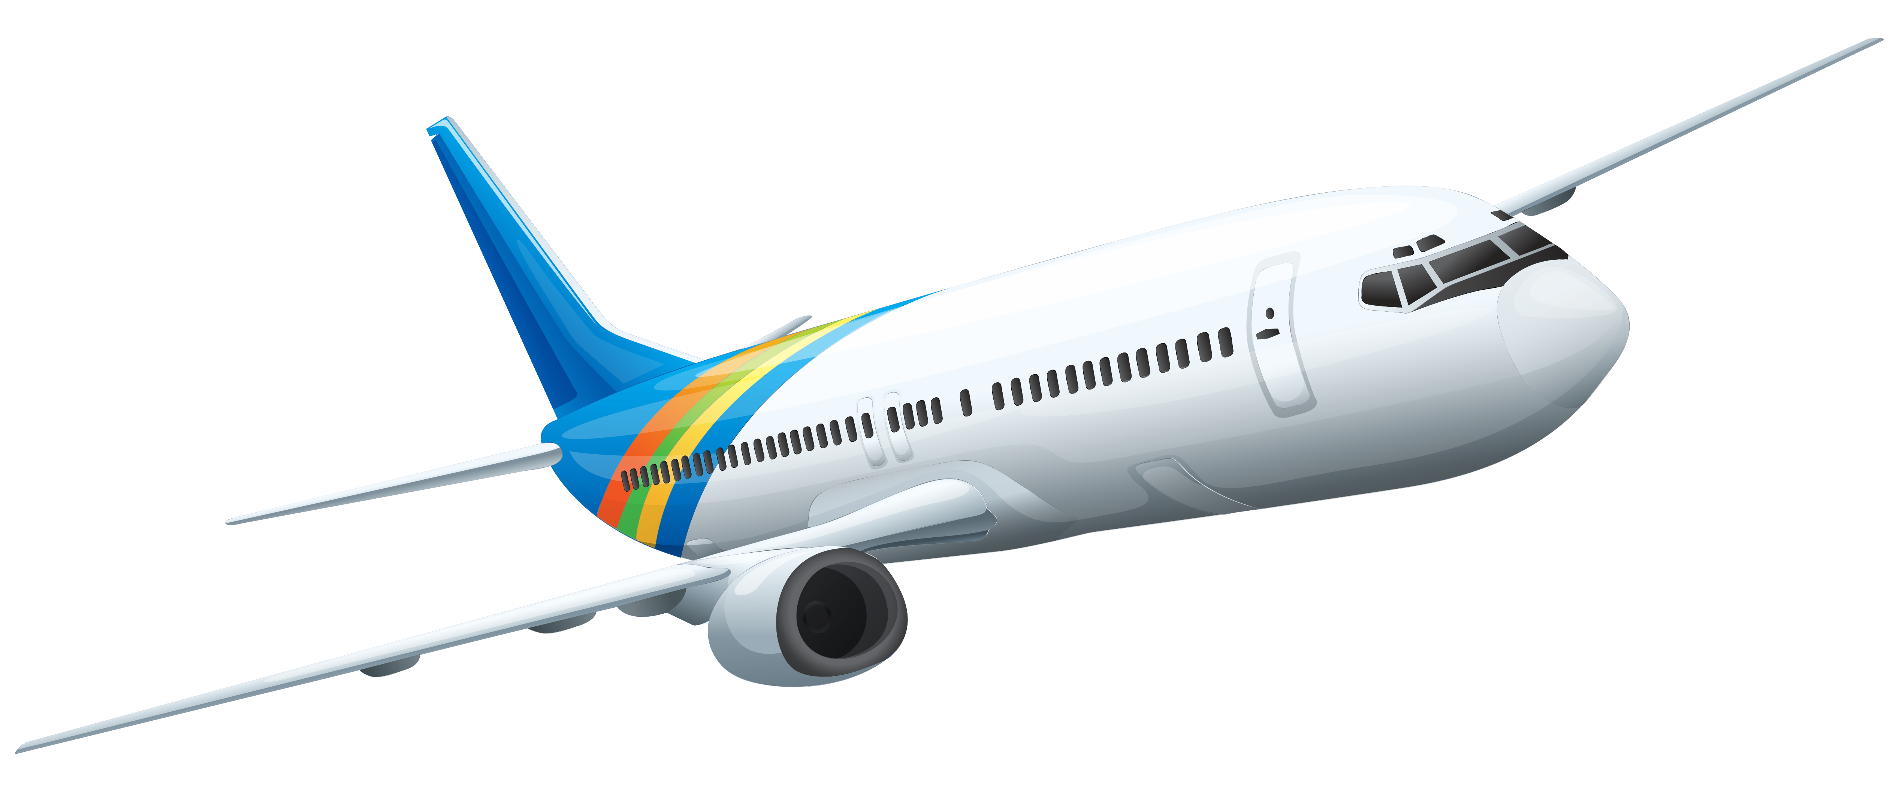
About me
I’m M. Pavan Kumar Reddy has completed Bcom Computer Applications
Learning data science can lead to diverse career opportunities, offers the chance to solve complex problems, has a significant impact on society and businesses, involves cutting-edge technologies, provides flexibility across industries, and often leads to high demand and competitive salaries.
Linkedin: www.linkedin.com/in/pavanreddy1828/
github: https://github.com/pavan1828

Slide 3

PROBLEM STATEMENT:
Analyzing and Recommending Flight Options Based on Cost and Convenience
OBJECTIVE:
To analyze the pricing dynamics across different cabin classes offered by airlines, aiming to understand the factors influencing price differentials and derive actionable insights to optimize revenue generation and enhance customer value proposition.

Slide 4

NumPy
Pandas
Beautiful Soup
Request
Matplotlib
RegEx
Seaborn
Libraries:

Slide 5

Website link:- Google Flights – Find cheap flight options and track prices
Sending requests to access the data.
Website Server Response and Scrapped data from web pages.
Tags('div', 'span', 'a').
Using the regex pattern to get the required datapoints.
WEB
SCRAPPING:

Slide 6
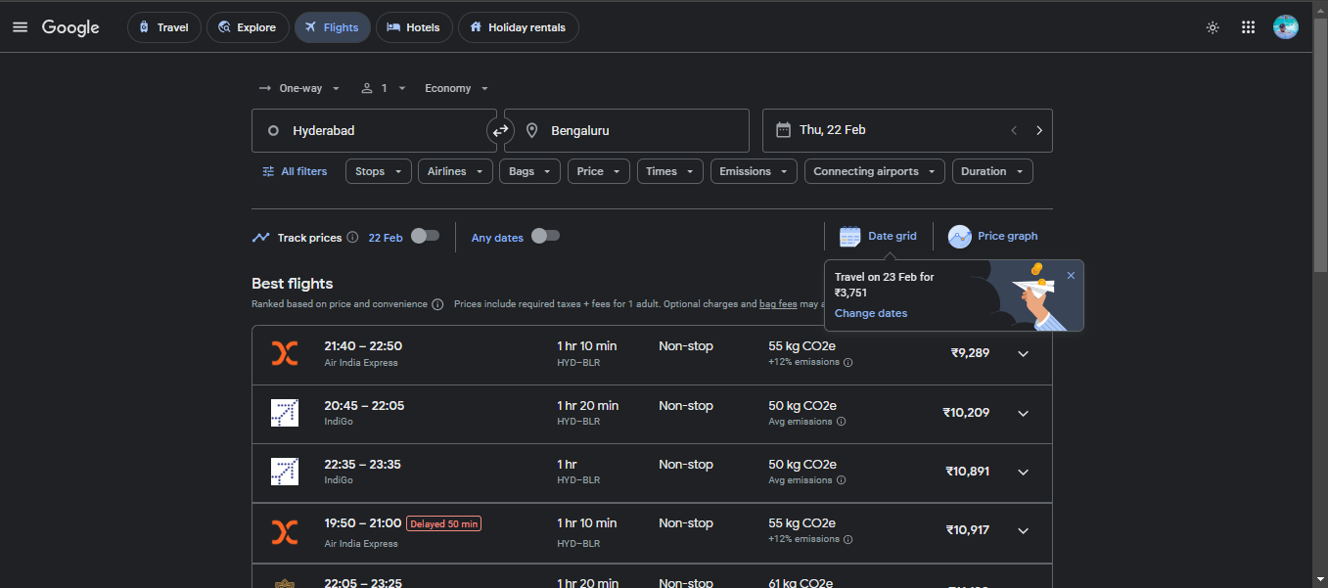
Web Page:

Slide 7

Airline: The name of the airline operating the flight.
Cabin: The class of cabin for the flight ( Economy, Premium Economy, business, First).
Departure Time: The time when the flight departs.
Arrival_Time: The time when the flight arrives.
Departure Place: The location from which the flight departs.
Arrival_place: The destination or arrival location of the flight.
Flight_Durations: The duration of the flight.
Stops: The number of stops during the flight.
Emission(in kgs): The emission level associated with the flight in kilograms
Prices: The price associated with the flight.
FEATURES:

Slide 8

Data collection
Data cleaning
Descriptive Statistics
Data Analysis
Conclusion
Key Tasks:

Slide 9
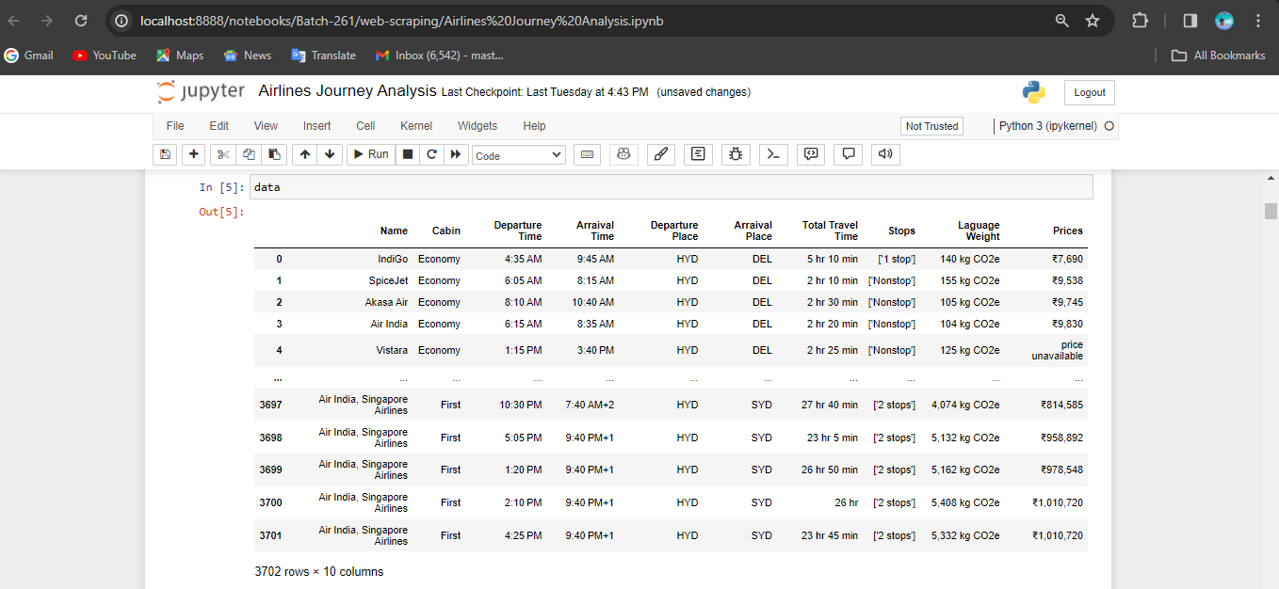
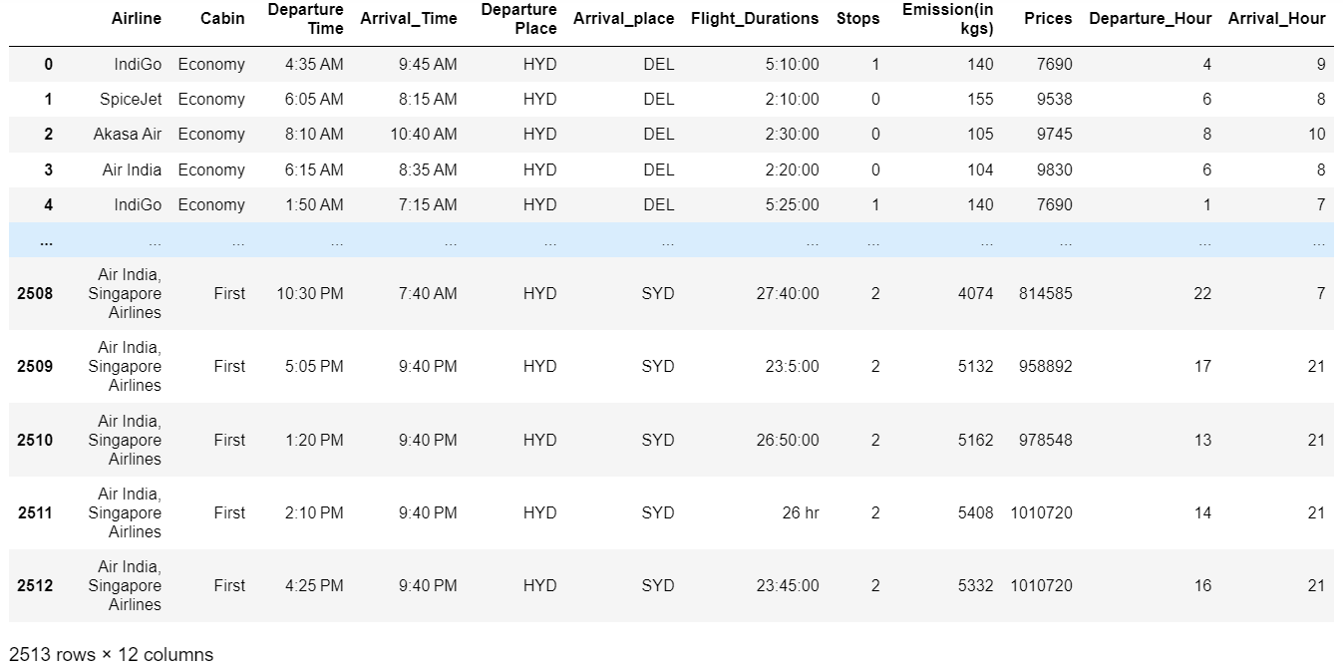
Raw Data :
Cleaned Data :

Slide 10
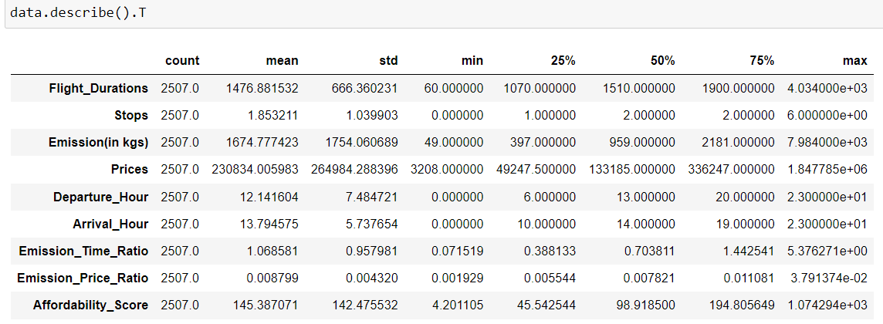
Descriptive Statistics:

Slide 11
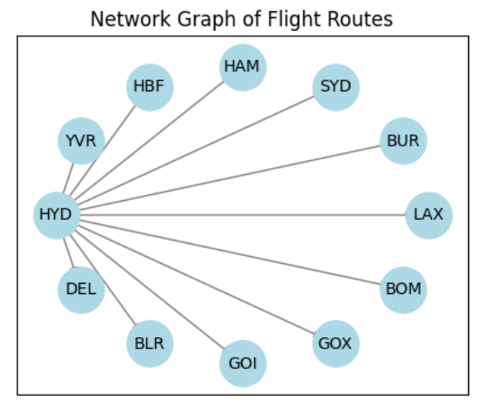
Network graph illustrating flight routes connecting various airport
HYD - Hyderabad
DEL - Delhi
BLR - Bangalore
GOI & GOX - Goa
BOM - Mumbai
LAX – Los Angeles
YUR - Canada
HBF & HAM - Germany
SYD - Australia
BUR – Burbank Airport(California)

Slide 12
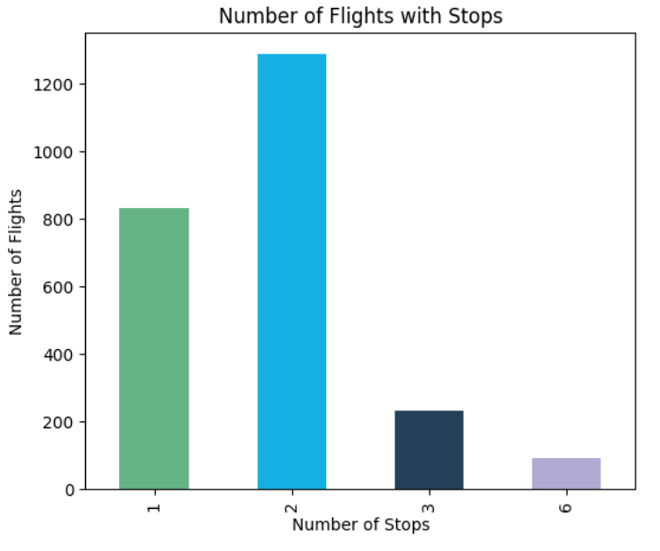
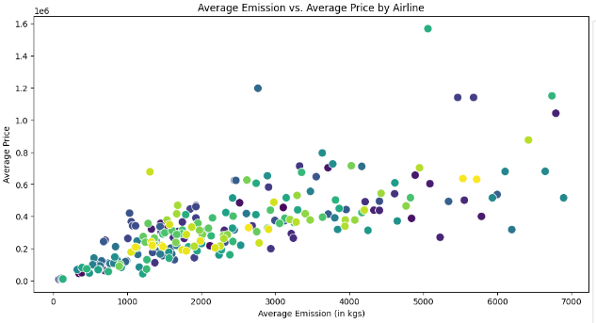
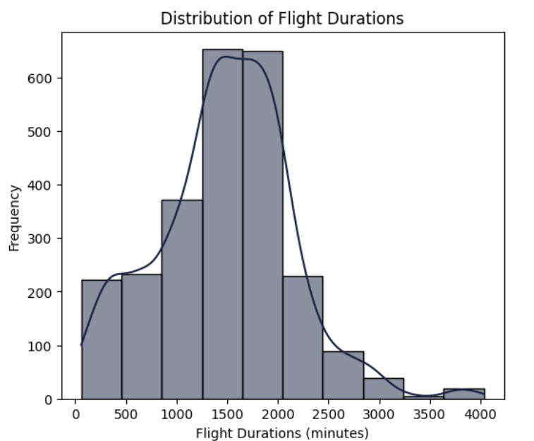
Factors to consider when choosing a flights
Two-stop flights are the most common, with more than 1000 flights.
Six-stop flights are the least common, with almost no flights.
Negative correlation: Higher emissions associated with lower prices; vice versa.
Etihad: Lowest emissions, highest prices. Air India: Highest emissions, lowest prices.
Histogram: x-axis shows flight durations (0-4000 mins), y-axis shows frequency (0-600+).
Peak around 1000-1500 mins; normal distribution indicates symmetric, bell-shaped data.

Slide 13
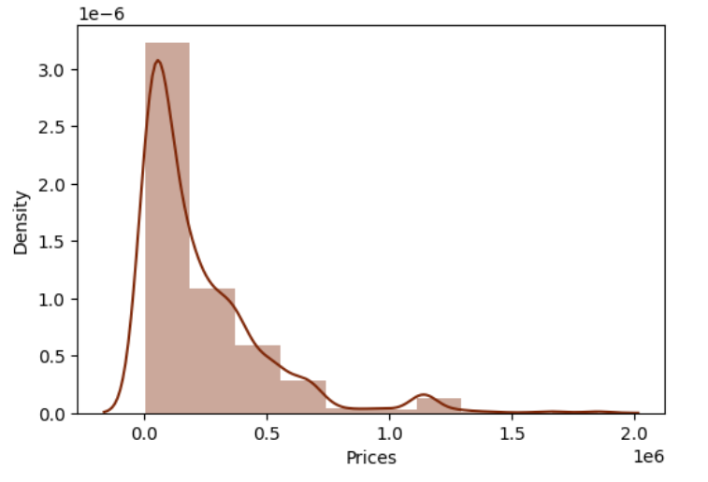
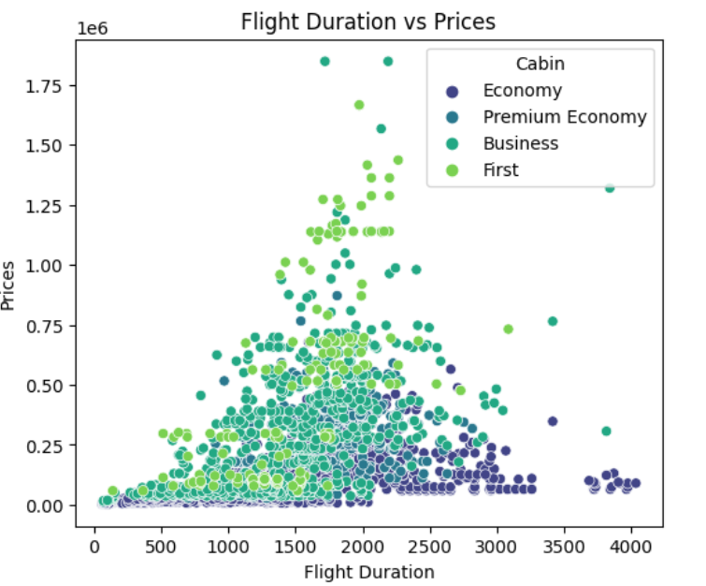
Most prices are below 500,000, with a peak density around 100,000.
Prices above 1,000,000 are very rare, with a very low density.
Flight duration generally correlates with higher prices, notably in premium cabins, yet numerous outliers suggest additional factors influencing pricing.

Slide 14
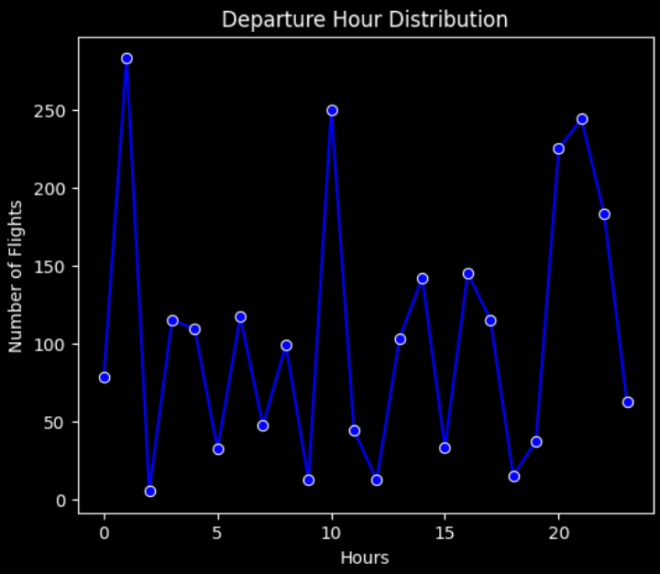
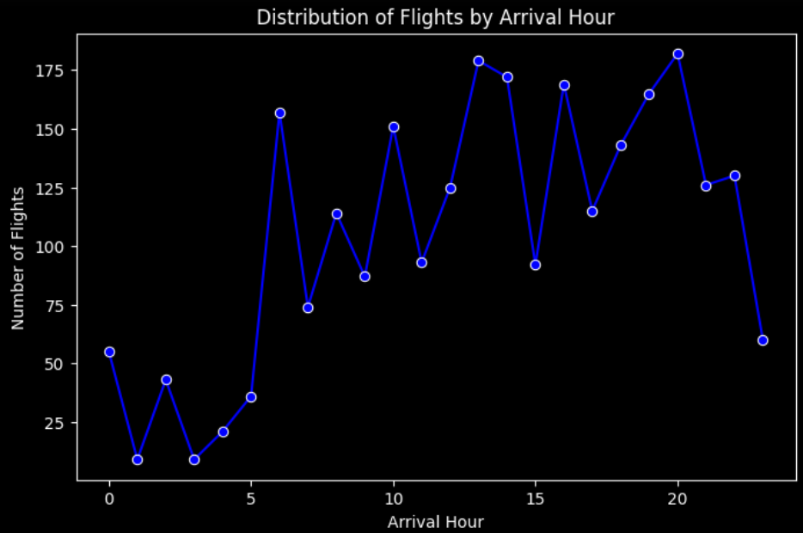
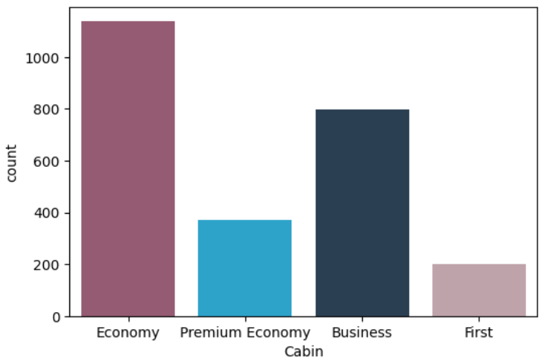
Analyzing flight durations based on convenience
Departure Peaks: Midnight, 10 AM, 3 PM, and 8 PM.
Valleys: Lower departures at 5 AM and 5 PM.
Busiest arrivals at 10, 15, and just before 20 hours.
Fluctuating patterns with troughs at 0, 5-10, 10-15, and after 20 hours.
popularity and availability of the cabin classes.

Slide 15
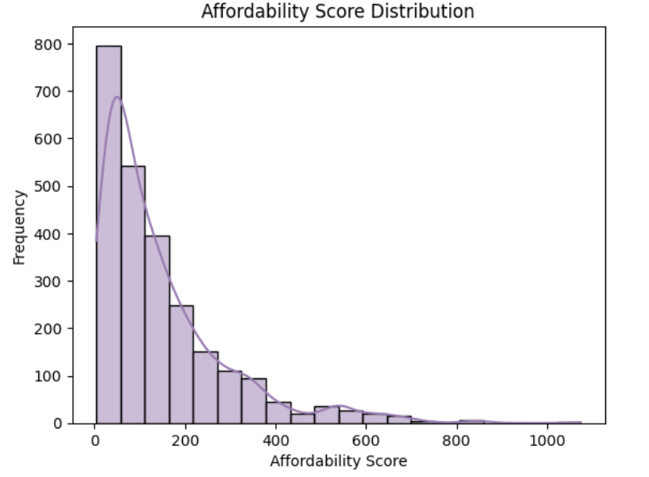
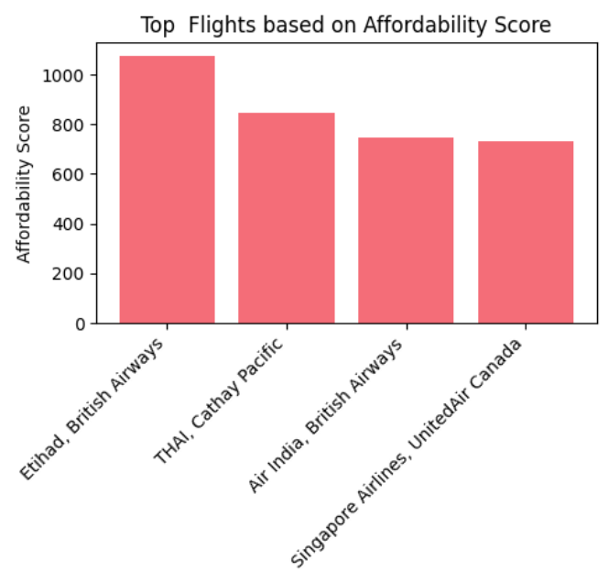
Balancing Cost and convenience
Etihad and British Airways excel in affordability, offering top value for money.
Air India and British Airways lag in affordability, providing the least value for money.
1000 affordability scores, with a cluster around 0-200 indicating low affordability.
Frequencies decrease notably as scores rise, reflecting diminishing affordability.

Slide 16

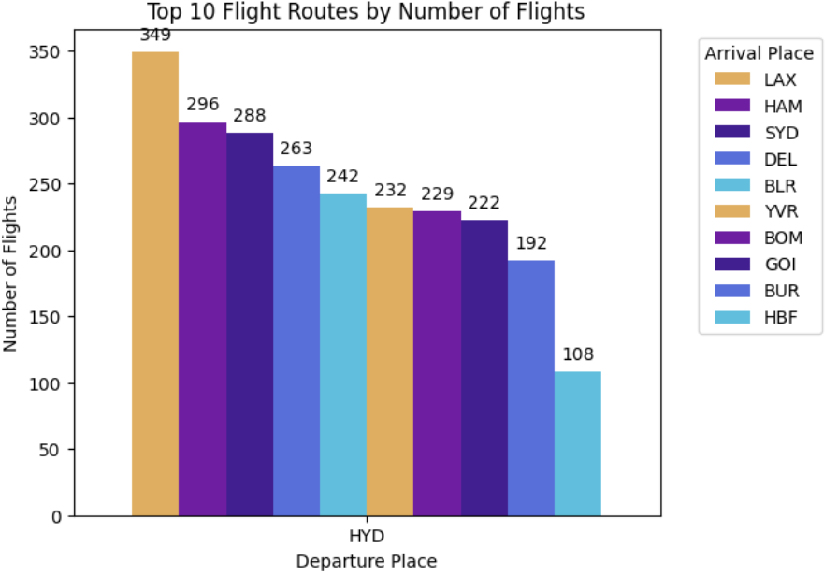


HYD
LAX
flight routes from HYD; LAX leads with 349 flights, followed by HAM (296) and SYD (288).

Slide 17
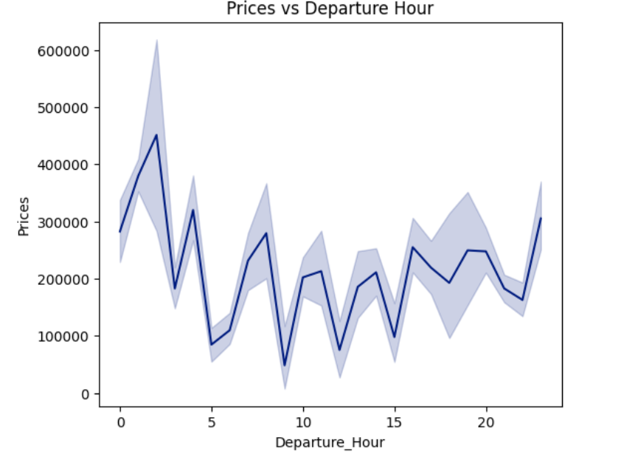
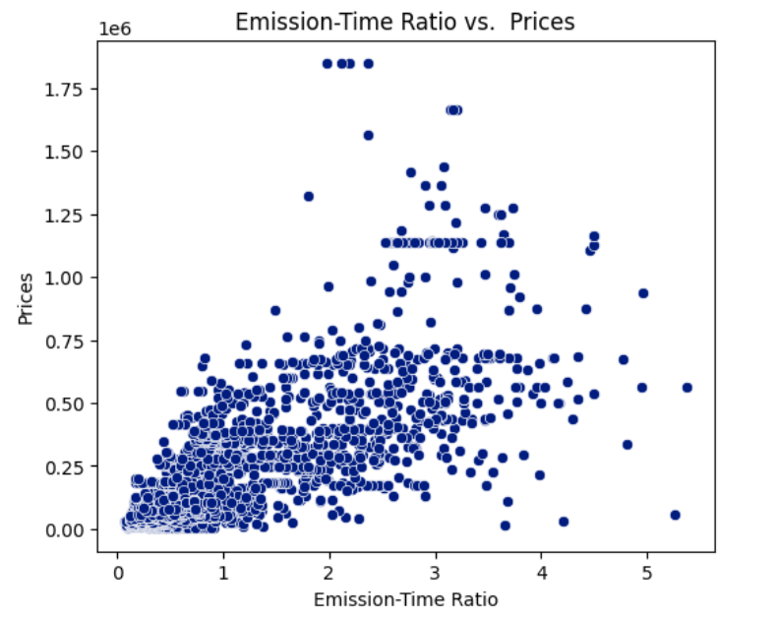
Peak hours: Higher prices (morning, noon, evening).
Off-peak hours: Lower prices (late morning, early afternoon, late night).
Lower emission-time ratio means greener travel.
Eco-friendly options tend to be pricier; price variations involve factors like demand and quality.

Slide 18
Recommendation:
Compare Prices: Utilize comparison websites like Skyscanner or Google Flights to find the best deals.
Flexibility in Travel Dates: Be open to adjusting travel dates for potential savings.
Explore Nearby Airports: Check nearby airports as they may offer cheaper options.
Price Drop Notifications: Enable notifications for price drops on preferred routes.
Consider Layovers: Longer layovers can sometimes result in cheaper fares.
Beware of Hidden Fees: Watch out for hidden charges when booking flights.
Travel During Off-Peak Times: Opt for quieter times of the year for better prices.
Use Rewards Points or Miles: Redeem any accumulated points or miles to reduce flight costs.
Read Reviews: Check reviews to ensure you're selecting a reputable airline.
Conclusion:
The correlation analysis unveils relationships between variables, setting the stage for deeper investigation. Affordability scores' distribution pattern hints at their impact on flight prices. Time-based analysis reveals price variations by departure hours, indicating potential pricing strategies. Scatterplot analysis illuminates emissions' influence on pricing. Cabin class notably affects prices, with distinct variations observed. Detailed examination of Economy cabin prices underscores patterns linked to departure hours. These findings collectively provide valuable insights for pricing strategies and decision-making in the airline industry.

Slide 19

THANK YOU

